Slide 1


IT Essentials for Health Managers
Course 2: Introduction to Cyber Security for Health Managers
Name: Desmond Sam, IT Officer – NSO
Date: 12th June, 2024

Slide 2

C H S (PNG)
Objectives
Introduction to Cyber Security
By the end of this workshop, participants will be able to:
Know the basics of cyber security.
Be able to spot common cyber threats.
Learn how to protect their devices and data.
Understand how to respond to cyber attacks.
Follow best practices for using the internet safely.
Objectives
Introduction
2.1
2.2
2.3
2.4
2.5
2.6
Q&A

Slide 3

C H S (PNG)
*
Introduction
Introduction to Cyber Security
What is Cyber Security?
  "Cyber" refers to computers, networks, and the internet—basically anything related to digital technology.
  “Cyber security" means keeping these computers, networks, and data safe from bad things like hackers or viruses. It's like putting locks on your house to protect it from thieves, but for computers and the internet.
Objectives
Introduction
2.1
2.2
2.3
2.4
2.5
2.6
Q&A

Slide 4
C H S (PNG)
*
Introduction
Introduction to Cyber Security
Importance of Cyber Security
  Cyber security is important because it keeps our online information safe from bad people who try to steal or damage it.
  Prevents hackers from accessing bank accounts and damaging devices.
  Protects personal information during online activities like shopping and social media use.
Objectives
Introduction
2.1
2.2
2.3
2.4
2.5
2.6
Q&A

Slide 5
2.1
Common Cyber Threads
C H S (PNG)
Introduction to Cyber Security
Malware: Bad software like viruses and spyware that can hurt devices or steal information.
  Example: A virus deleting important files.
Phishing: Tricks to get private information by acting like a trusted person, often through emails.
  Example: A fake email asking for bank login details.
Ransomware: Software that locks files or computers and asks for money to unlock them.
  Example: A message demanding payment to use encrypted files.
Objectives
Introduction
2.1
2.2
2.3
2.4
2.5
2.6
Q&A

Slide 6
2.2
Basic Concepts of Cyber Security
C H S (PNG)
Introduction to Cyber Security
Malware
  Types:
    Viruses (spread through files),
    worms (spread through networks), and
    spyware (gets data without asking).
  Spread:
    Comes through emails,
    downloads, and
    USB drives.
Objectives
Introduction
2.1
2.2
2.3
2.4
2.5
2.6
Q&A

Slide 7
2.2
Basic Concepts of Cyber Security
C H S (PNG)
Introduction to Cyber Security
Phishing
  How to know:
    Urgent words, strange links, and checking sender emails.
  How to stay safe:
    Don't click on strange links or share private info by email.
Objectives
Introduction
2.1
2.2
2.3
2.4
2.5
2.6
Q&A

Slide 8
2.2
Basic Concepts of Cyber Security
C H S (PNG)
Introduction to Cyber Security
Ransomware
  How it spreads:
    Comes through bad emails or websites. Locks files until you pay.
  How to stay safe:
    Keep backups of files and don't click on bad links.
Objectives
Introduction
2.1
2.2
2.3
2.4
2.5
2.6
Q&A

Slide 9
2.3
Protecting Your Devices
C H S (PNG)
Introduction to Cyber Security
1. Using Strong Passwords
  Make strong passwords with letters, numbers, and symbols.
  For example : use 'S3cur3P@ssw0rd!' not '123456’.
2. Keeping Software Updated
  Updates fix problems. Always keep your programs up-to-date.
3. Using Antivirus Programs
  Use good antivirus software to stop bad software.
Objectives
Introduction
2.1
2.2
2.3
2.4
2.5
2.6
Q&A

Slide 10
2.4
Safe Internet Practices
C H S (PNG)
Introduction to Cyber Security
Recognizing Phishing Emails
  Watch for:
    bad spelling and
    requests for private info.
    Check if emails are real.
Objectives
Introduction
2.1
2.2
2.3
2.4
2.5
2.6
Q&A

Slide 11
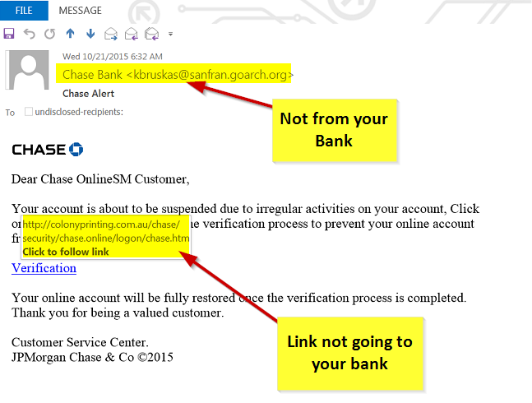
2.4
Safe Internet Practices
C H S (PNG)
Introduction to Cyber Security
Recognizing Phishing Emails
Objectives
Introduction
2.1
2.2
2.3
2.4
2.5
2.6
Q&A

Slide 12
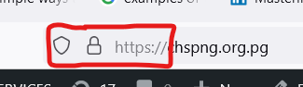
2.4
Safe Internet Practices
C H S (PNG)
Introduction to Cyber Security
Secure Browsing Habits
  Use 'https' websites for safe sharing. Don't get files from places you don't trust.
Objectives
Introduction
2.1
2.2
2.3
2.4
2.5
2.6
Q&A
Secure Online Communication
  Use safe apps like WhatsApp for private things. Don't tell everyone your private info online.

Slide 13
2.5
Responding to Cyber Incidents
C H S (PNG)
Introduction to Cyber Security
Recognizing a Security Breach
  Know when something bad happens like slow computers or weird pop-ups.
Steps to Take After a Breach
  Run antivirus scans. Change bad passwords. Fix your things from the last safe copy.
Reporting Incidents
  Tell IT support or the police. Write down what happened.
Objectives
Introduction
2.1
2.2
2.3
2.4
2.5
2.6
Q&A

Slide 14
2.6
Best Practices and Tips
C H S (PNG)
Introduction to Cyber Security
1. Regular Backups
  Keep extra copies of your things. This helps if something gets lost.
2. Two-Factor Authentication (2FA)
  Make things safer by needing more than one code to log in.
3. Secure Use of Social Media
  Change settings so only friends see your things. Don't share secret info.
Objectives
Introduction
2.1
2.2
2.3
2.4
2.5
2.6
Q&A

Slide 15

?
Q & A / Open Discussions
C H S (PNG)
Introduction to Cyber Security
Objectives
Introduction
2.1
2.2
2.3
2.4
Q&A

