Slide 1



IT Essentials for Health Managers
Course: 1 Basic Computer Care and Maintenance
Name: Desmond Sam, IT Officer – NSO
Date: 19th June, 2024

Slide 2

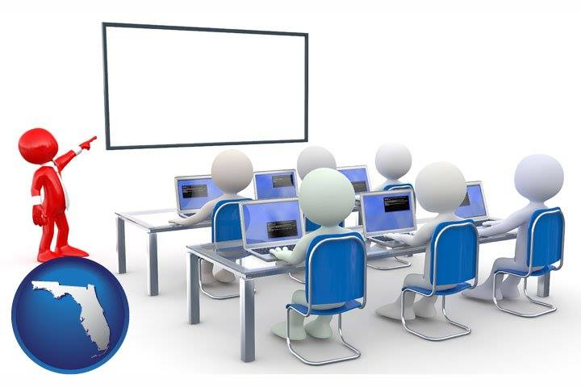
C H S (PNG)
Objective
Basic Computer Care & Maintenance
Equip health managers with practical IT skills they can use right away in their daily work.
Objective
Introduction
1.1
1.2
1.3
1.4
Activities
Q&A
Notes:
The objective, or goal or what we want to achieve by the end of this workshop is to:
Equip health managers with practical IT skills they can use right away in their daily work.

Slide 3
C H S (PNG)
*
Introduction
Basic Computer Care & Maintenance
Objective
This workshop teaches health managers essential IT skills to care for their PCs and keep them running well for a long time.
Outline
  1.1. Basic PC Care and Maintenance
  1.2. Useful Software Tools
  1.3. PC Security: Anti-virus (AVG, MalwareBytes & Smadav)
  1.4. Basic Practices for Backing up Files
  Conclusion and Q&A
Introduction
1.1
1.2
1.3
1.4
Activities
Q&A

Slide 4
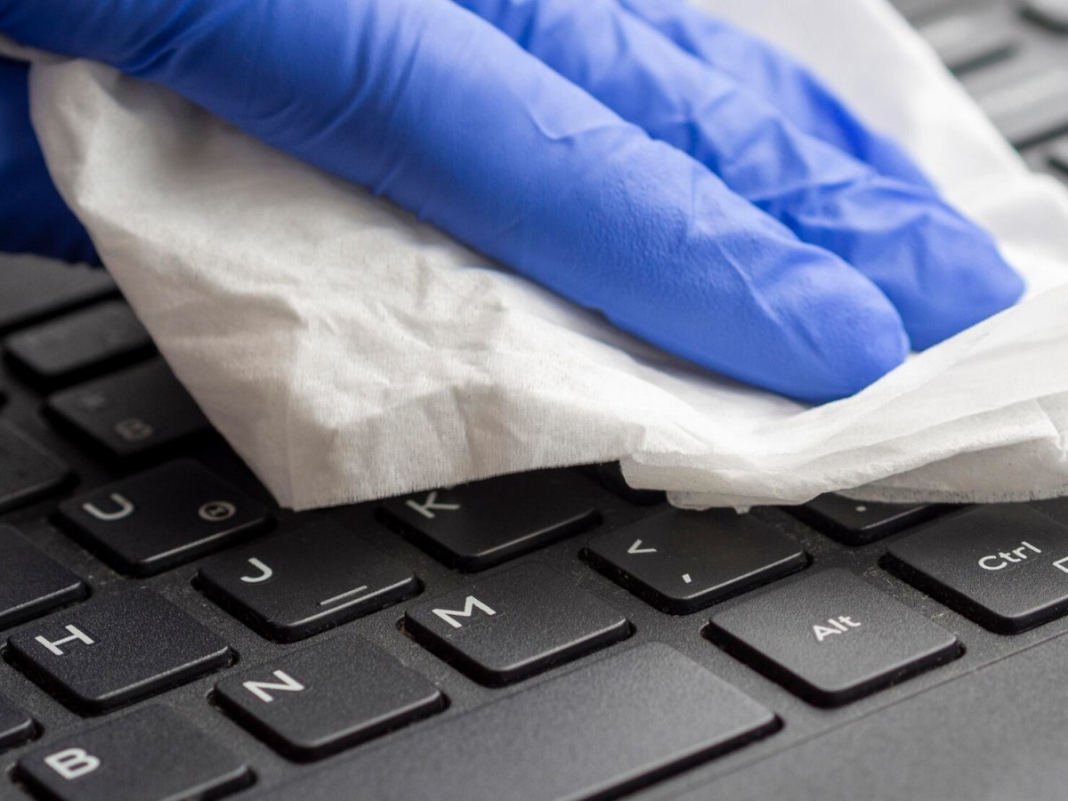
1.1
Basic PC Care and Maintenance
C H S (PNG)
Basic Computer Care & Maintenance
PC Care
  Cleaning
    Keyboard, screen, vents
Objective
Introduction
1.1
1.2
1.3
1.4
Activities
Q&A

Slide 5
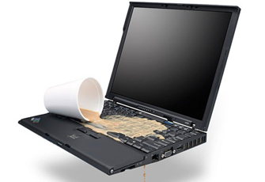

1.1
Basic PC Care and Maintenance
C H S (PNG)
Basic Computer Care & Maintenance
PC Care
  Proper handling
    Proper Shutdown Procedure
    Check Before Closing the Laptop
    Place your computer on a flat and stable surface
    Avoid Placing Heavy Objects on Your Laptop
    Keep away from liquids and foods, don’t use with wet hands
    Keep Away from Children
Objective
Introduction
1.1
1.2
1.3
1.4
  Battery care
    Avoid Extreme Temperatures
    Regularly Discharge (100%) and Recharge (20%)
    Use Proper Charging Practices: Correct charger, avoid over-charging
Activities
Q&A

Slide 6
1.1
Basic PC Care and Maintenance
C H S (PNG)
Basic Computer Care & Maintenance
Common PC Issues | Causes
Slow Performance | Too many programs running, lack of disk space, malware.
Freezing or Crashing | Software conflicts, overheating, hardware failures.
Internet Connectivity Issues | Loose connections, hotspot Issues, ISP issues, network settings.
Software Errors | Corrupted files, incompatible software, bugs
Hardware Problems | Faulty components, loose connections, physical damage.
Objective
Introduction
1.1
1.2
1.3
1.4
Activities
Q&A

Slide 7
1.1
Basic PC Care and Maintenance
C H S (PNG)
Basic Computer Care & Maintenance
Common PC Issues | Troubleshooting Steps
Slow Performance Freezing or Crashing | - Disable startup programs - Close Unnecessary Programs, Check Task Manager - Free Up Disk Space - Run a Virus Scan - System restore point to revert to a stable state. - Restart Your Computer - Update Software - Use cleanup utility tool
Internet Connectivity Issues | Ensure all cables are properly connected, Restart Hotspot
Software Errors | System restore point to revert to a stable state.
Hardware Problems | Use built-in troubleshooters in your operating system
Objective
Introduction
1.1
1.2
1.3
1.4
Activities
Q&A

Slide 8

1.1
Basic PC Care and Maintenance
C H S (PNG)
Basic Computer Care & Maintenance
When to Seek Professional Help
  Persistent Problems
  Hardware Issues
  Data Recovery
  Virus Infections
  Network Issues
  Upgrades and Installations
Objective
Introduction
1.1
1.2
1.3
1.4
Activities
Q&A

Slide 9












1.2
Useful Software Tools
C H S (PNG)
Basic Computer Care & Maintenance
Essential Software
Objective
Introduction
1.1
Antivirus
1.2
OpenShell
Windows start menu
Cleanup & Optimization
1.3
1.4
MS Office Alternatives
Activities
Q&A
File Recovery
Archiving
PDF Reader
Video calls, conference
Email Client

Slide 10
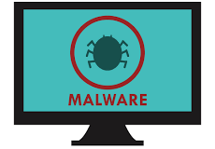
C H S (PNG)
1.3
PC Security: Anti-virus (AVG, MalwareBytes, & Smadav)
Basic Computer Care & Maintenance
What is an antivirus software?
  Antivirus software is a program designed to detect and remove harmful software (malware) from your computer
  AVG and Smadav
Objective
Introduction
1.1
1.2
1.3
1.4
  What is a malware?
  Malware is any software designed to harm your computer or steal your information. This includes viruses, spyware, and ransomware.
Activities
Q&A

Slide 11
C H S (PNG)
1.3
PC Security: Anti-virus (AVG, MalwareBytes, & Smadav)
Basic Computer Care & Maintenance
Installing and Updating AVG and Smadav
  Download online or offline installer files and install them
  Updates automatically when connected to the internet
  Configure scheduled scans
  Understanding scan results
Objective
Introduction
1.1
1.2
1.3
1.4
Activities
Q&A
Conclusion

Slide 12
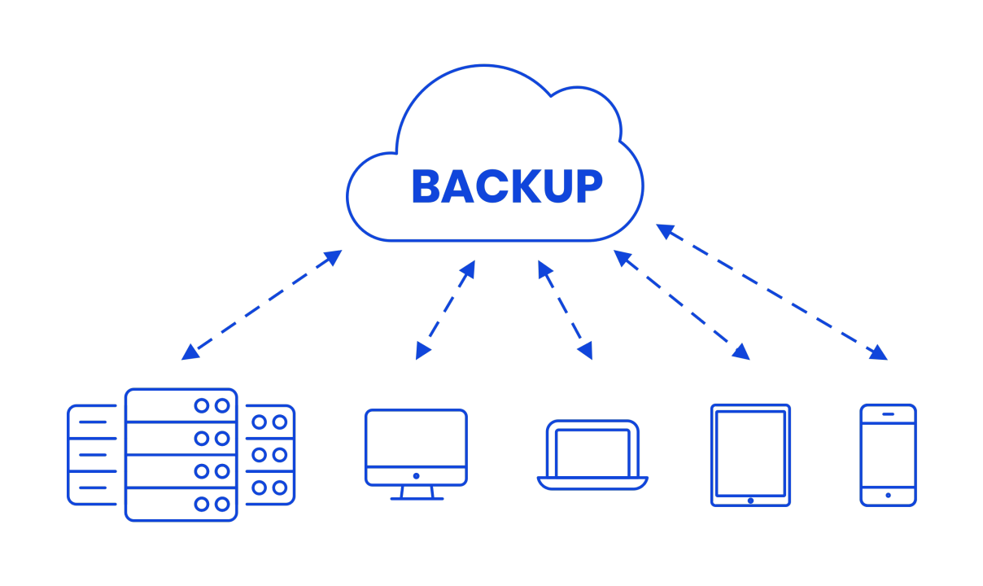
1.4
Basic Practices for Backing up Files
C H S (PNG)
Basic Computer Care & Maintenance
Best Practices for Data Backup
  Regular Backups
  Multiple Locations
  Verify Backups
  Use Reliable Tools
  Automate When Possible
Objective
Introduction
1.1
1.2
1.3
1.4
Activities
Q&A

Slide 13

1.4
Basic Practices for Backing up Files
C H S (PNG)
Basic Computer Care & Maintenance
Steps to Manually Backup Files
  Identify Important Files
  Choose a Backup Location
  Copy Files
Objective
Introduction
1.1
1.2
1.3
1.4
Activities
Q&A

Slide 14

1.4
Basic Practices for Backing up Files
C H S (PNG)
Basic Computer Care & Maintenance
Online Backup Using Google Drive
  Install Google Drive and Sign in
  Sync Folders
  Manual Backup to Google Drive
  Accessing Your Files
Objective
Introduction
1.1
1.2
1.3
1.4
Activities
Q&A

Slide 15
Activities
C H S (PNG)
Basic Computer Care & Maintenance
Activity 1: Creating a Restore Point
  Click on the Start Menu.
  Type "Create a restore point" and select the matching result.
  In the System Properties window, select the drive you want to protect (usually the C: drive).
  Click "Configure" and ensure that system protection is turned on.
  Click "OK."
  Click "Create" in the System Properties window.
  Give your restore point a name (e.g., "Before installing new software").
  Click "Create" again and wait for the process to complete.
Objective
Introduction
1.1
1.2
1.3
1.4
Activities
Q&A

Slide 16
Activities
C H S (PNG)
Basic Computer Care & Maintenance
Activity 2: Disabling Startup Program
  Right-click on the taskbar and select "Task Manager" from the menu.
  In the Task Manager window, click on the "Startup" tab.
  You'll see a list of programs that start automatically when you turn on your computer.
  Select the program you want to disable from the list.
  Click on the "Disable" button at the bottom right corner of the window.
  Repeat this process for any other programs you want to disable from starting up automatically.
  Close the Task Manager window when you're done.
Objective
Introduction
1.1
1.2
1.3
1.4
Activities
Q&A

Slide 17
Activities
C H S (PNG)
Basic Computer Care & Maintenance
Activity 3: Steps to Use Windows Troubleshooter
  Press Windows key + I to open Settings.
  Click on "Update & Security."
  Click on "Troubleshoot" in the left pane.
  Select the appropriate troubleshooter (e.g., Internet Connections).
  Click "Run the troubleshooter."
  Follow the on-screen instructions.
  Restart your computer if prompted.
Objective
Introduction
1.1
1.2
1.3
1.4
Activities
Q&A

Slide 18
Activities
C H S (PNG)
Basic Computer Care & Maintenance
Activity 4: Installing Google Drive
  Install Google drive file
  Log in to your Google Account
  Go to “Computer to See your Google Drive”
  Work and save files directly from the Google Drive
Objective
Introduction
1.1
1.2
1.3
1.4
Activities
Q&A

Slide 19
Activities
C H S (PNG)
Basic Computer Care & Maintenance
Activity 4: Steps to Access and Setting up Emails
  Connect to hotspot: “Huon Gulf Guest Access”
  Enter your Room Number
  Enter your Last Name
Objective
Introduction
1.1
1.2
1.3
1.4
Activities
Q&A

Slide 20

Activities
C H S (PNG)
Basic Computer Care & Maintenance
Activity 4: Steps to Access and Setting up Emails
  Open a web browser
  Enter this URL: chspng.org.pg/webmail
  Enter your CHS email address and
  your password is: hm@2024
  Select a web-mail client:
Objective
Introduction
1.1
1.2
1.3
1.4
Activities
Q&A

Slide 21

?
Q & A / Open Discussions
C H S (PNG)
Basic Computer Care & Maintenance
Objective
Introduction
1.1
1.2
1.3
1.4
Activities
Q&A

