Slide 1



Christian Health Services (PNG)
Financial Reporting System
Training

Slide 2

C H S (PNG)
Objective
Financial Reporting System
Training
Participants will learn and be familiar with the Reporting templates and its categories.
Participants will learn how to accurately report employee salary and operational expenses using a standardized template, ensuring transparency and consistency in financial reporting.
Objective
Introduction
Overview
Salary
Operational
Activity
Recap
Q&A
Conclusion

Slide 3

C H S (PNG)
1
Introduction to Reporting Requirement
Financial Reporting System
Training
Purpose of this this training;
Ensure that you are upskilled on how to do accurate reporting especially with the financial report.
To clear confusion and correct certain errors during reporting, and
To make aware of the importance of accurate reporting.
Importance of Accurate Reporting
What is the importance of Accurate Reporting?
Properly Track and Acquit Expenditures – Ensure that the funds are spend appropriately.
Budgeting – it gives a clear insight on how to develop a realistic budget.
Decision Making – It guides strategic decisions that align with our goals, objectives, and initiatives.
Objective
Introduction
Overview
Salary
Operational
Activity
Recap
Q&A
Conclusion

Slide 4

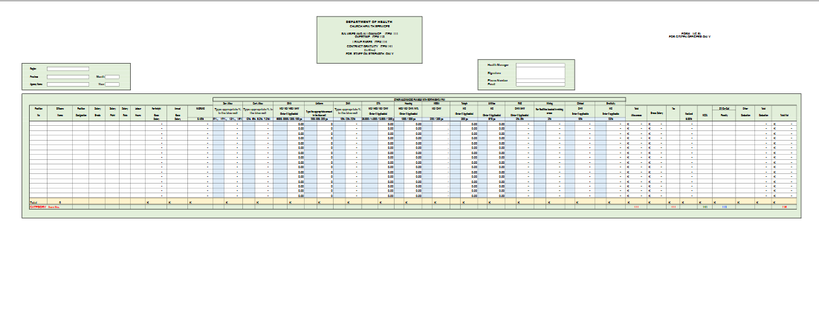
2
Overview of the Reporting Templates
C H S (PNG)
Financial Reporting System
Salary Data Entry Form 1 – The Key Component
Part 1 – Contain Agency Information and Reporting Date
Part 2 – Contain Position Information and Base Salary
Part 3 – Contain Allowances
Part 4 – Contain Deductions and Net Pay
Training
Objective
Introduction
Overview
Salary
Current Template
Operational
Activity
Recap
Q&A
Conclusion

Slide 5
2
Overview of the Reporting Templates
C H S (PNG)
Financial Reporting System
Salary Data Entry Form 1 – The Key Component
Part 1 – Contain Agency Information and Reporting Date
Part 2 – Contain Position Information and Base Salary
Part 3 – Contain Allowances
Part 4 – Contain Deductions and Net Pay
Training
Objective
Introduction
Overview
Salary
Current Template
Operational
Activity
Recap
Q&A
Conclusion

Slide 6
2
Overview of the Reporting Templates
C H S (PNG)
Financial Reporting System
Salary Data Entry Form 1 – The Key Component
Part 1 – Contain Agency Information and Reporting Date
Part 2 – Contain Position Information and Base Salary
Part 3 – Contain Allowances
Part 4 – Contain Deductions and Net Pay
Training
Objective
Introduction
Overview
Salary
Current Template
Operational
Activity
Recap
Q&A
Conclusion

Slide 7
2
Overview of the Reporting Templates
C H S (PNG)
Financial Reporting System
Salary Data Entry Form 1 – The Key Component
Part 1 – Contain Agency Information and Reporting Date
Part 2 – Contain Position Information and Base Salary
Part 3 – Contain Allowances
Part 4 – Contain Deductions and Net Pay
Training
Objective
Introduction
Overview
Salary
Current Template
Operational
Activity
Recap
Q&A
Conclusion

Slide 8
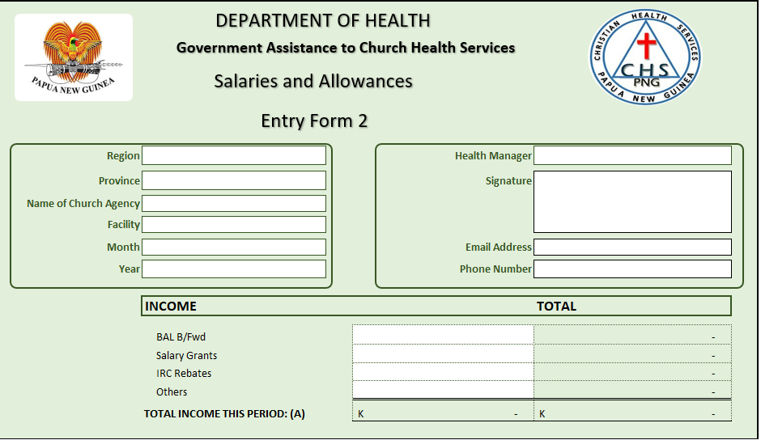
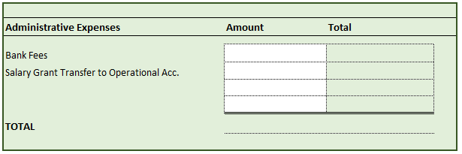
2
Overview of the Reporting Templates
C H S (PNG)
Financial Reporting System
Salary Data Entry Form 2 – The Key Component
Part 1 – Contain Agency Information and Reporting Date
Part 2 – Contain the Source of Income
Part 3 – Contain Administrative Expenses
Part 4 – Other Salary Expenditure
Training
Objective
Introduction
Overview
Salary
Operational
Activity
Recap
Q&A
Conclusion

Slide 9
2
Overview of the Reporting Templates
C H S (PNG)
Financial Reporting System
Salary Data Entry Form 2 – The Key Component
Part 1 – Contains Agency Information and Reporting Date
Part 2 – Contains the Source of Income
Part 3 – Contains Administrative Expenses
Part 4 – Other Salary Expenditures
Training
Objective
Introduction
Overview
Salary
Operational
Activity
Recap
Q&A
Conclusion

Slide 10
2
Overview of the Reporting Templates
C H S (PNG)
Financial Reporting System
Salary Data Entry Form 2 – The Key Component
Part 1 – Contains Agency Information and Reporting Date
Part 2 – Contains the Source of Income
Part 3 – Contains Administrative Expenses
Part 4 – Other Salary Expenditures
Training
Objective
Introduction
Salary Grant Transfer to Operational Acc.
Overview
Salary
Operational
Activity
Recap
Q&A
Conclusion

Slide 11
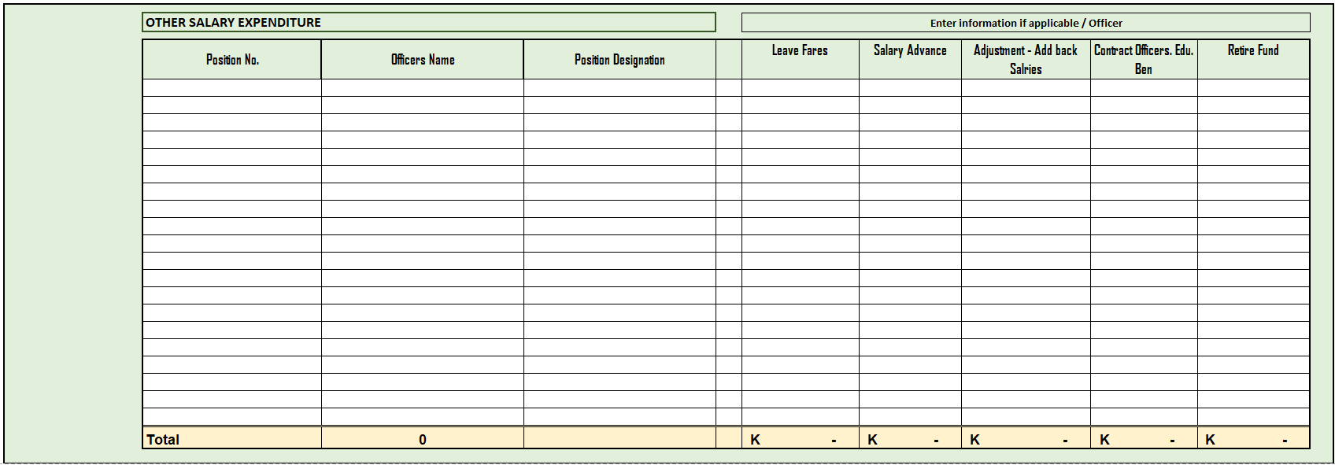
2
Overview of the Reporting Templates
C H S (PNG)
Financial Reporting System
Salary Data Entry Form 2 – The Key Component
Part 1 – Contains Agency Information and Reporting Date
Part 2 – Contains the Source of Income
Part 3 – Contains Administrative Expenses
Part 4 – Other Salary Expenditures
Training
Objective
Introduction
Overview
Salary
Operational
Activity
Recap
Q&A
Conclusion

Slide 12
2
Overview of the Reporting Templates
C H S (PNG)
Financial Reporting System
Training
Objective
Introduction
Overview
Salary
Operational
Activity
Recap
Q&A
Conclusion

Slide 13

2
Overview of the Reporting Templates
C H S (PNG)
Financial Reporting System
Training
Salary – The Key Component
Part 1 – Contain Agency Information and Reporting Date
Part 2 – Contain Position Information and Base Salary
Part 3 – Contain Allowances
Part 4 – Contain Deductions and Net Pay
Objective
Introduction
Overview
Salary
Operational
Activity
Recap
Q&A
Conclusion

Slide 14

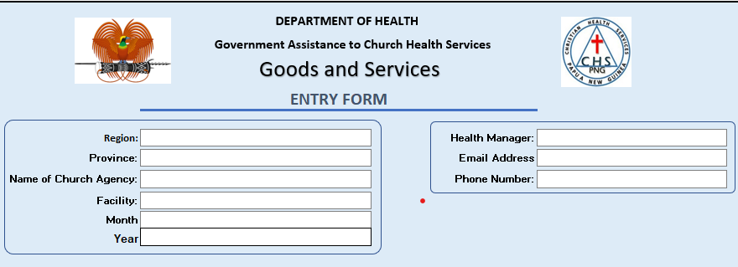
2
Overview of the Reporting Templates
C H S (PNG)
Financial Reporting System
Operational – The Key Component
Part 1 – Agency
Information and
Reporting Date
Part 2 –
Income Details
Part 3 –
Expenditure
Details
Training
Objective
Introduction
Overview
Salary
Operational
Activity
Recap
Q&A
Conclusion

Slide 15
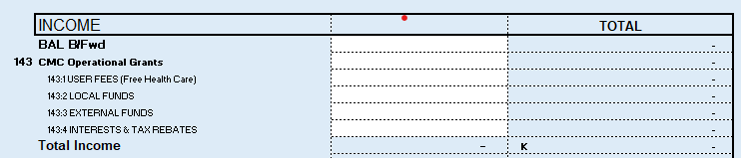
2
Overview of the Reporting Templates
C H S (PNG)
Financial Reporting System
Operational – The Key Component
Part 1 – Agency
Information and
Reporting Date
Part 2 –
Income Details
Part 3 –
Expenditure
Details
Training
Objective
Introduction
Overview
Salary
Operational
Activity
Recap
Q&A
Conclusion

Slide 16
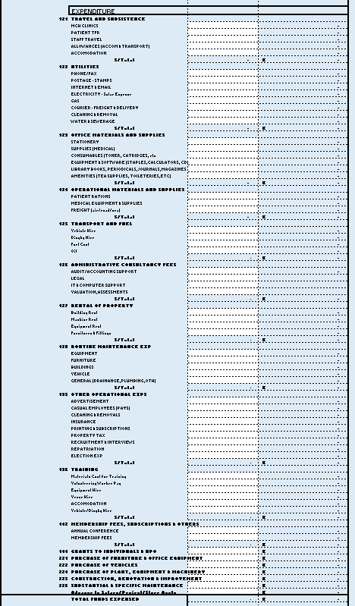
2
Overview of the Reporting Templates
C H S (PNG)
Financial Reporting System
Operational – The Key Component
Part 1 – Agency
Information and
Reporting Date
Part 2 –
Income Details
Part 3 –
Expenditure
Details
Training
Objective
Introduction
Overview
Salary
Operational
Activity
Recap
Q&A
Conclusion

Slide 17

3
Salary Reporting Templates
C H S (PNG)
Financial Reporting System
Training
Objective
How to accurately enter the Data
Enter correctly the data as specified by the template
The Base salary must be taken from the standard government salary scale 2019
Allowances (if applicable), must be calculated according to the specific amount or percentage as stipulated by its cadre.
Tax and Nasfund are compulsory and must be recorded accordingly.
It is very important to regularly update records to reflect any changes in employment status or salary components.
Avoid frequent Copy Paste – to execute this, make sure that the records are correct and current.
Introduction
Overview
Salary
Operational
Activity
Recap
Q&A
Conclusion

Slide 18
4
Operational Reporting Templates
C H S (PNG)
Financial Reporting System
Training
Objective
How to accurately enter Data
You must identify the common expenditure component (e.g. Utilities, office supplies, transport, and fuel etc.)
Enter correctly the data as specified by the template
It is very important to produce and document receipts and invoice for prove of transactions. This is to capture factual records and promote transparency and accountability.
Introduction
Overview
Salary
Operational
Activity
Recap
Q&A
Conclusion

Slide 19

6
Recap
C H S (PNG)
Financial Reporting System
Training
The key points covered throughout the training session are;
Main components of the reporting templates
Enter data according to its specified field in the template
Make sure to enter factual and up-to-date data
Always remember to document and produce supporting documents like receipts and invoices.
Remember that accurate reporting will give an insight on Data-Driven-Decision-Making for better outcome.
Objective
Introduction
Overview
Salary
Operational
Activity
Recap
Q&A
Note:
Conclusion
For the Salary, you have to continue until you complete all the salary records of the staffs in your Agency
Both forms (Salary/Operational) are to be submitted every month
For the Receipts, Invoices and other attachments, we will late create a button for you to upload this documents

Slide 20

7
Q&A / Open Discussions
C H S (PNG)
Financial Reporting System
Training
Objective
What are some areas that you face difficulty in your reporting?
Are there any experiences that you want to share that can enlighten us on the aspect of reporting?
Is there anything that you think we can consider to improve our Reporting System?
What do you think about the New Reporting System?
Is there anything you’ve noticed, that you want to discus with us?
Introduction
Overview
Salary
Operational
Activity
Recap
Q&A
Remember:
Conclusion
Your thoughts and ideas will help us improve our Reporting System
Your contribution of ideas will have a great impact in the overall reports of CHS
Through Asking Questions and open discussions, it will help others who are in need or in doubt.

Slide 21

8
Conclusion
C H S (PNG)
Financial Reporting System
Some of the Tips for accuracy in reporting?
Double check data entry for errors and inconsistencies
Keep records organised and up-to-date
Seek clarification from your managers or CHS office personnel when in doubt.
Point of Contact.
The first point of contact is the CEO and cc to Finance Managers. They will contact CHS officer or they can direct you to contact CHS officer.
Here are the CHS Personnels and their respective roles;
To submit report and get updates – Jerry Kaino Data Processing Officer
For Grands and Funds distribution – Mr. Tapia, Mr. Rutmat and Mr. Langer.
For salary related issues – Respective Regional Payroll Officers and The HR Manageress.
For Technical issues relating to Reporting template – Ignatius Jerrifia
Training
Objective
Introduction
Overview
Salary
Operational
Activity
Recap
Officers Name | Position | Email | Phone
Mr. Ulch Tapia | CEO | utapia@chspng.org.pg
Mr. Bernard Rutmat | DCEO | brutmat@chspng.org.pg
Mr. David Langer | Finance Manager | dlanger@chspng.org.pg
Rosemary Mocke | P/O Highlands | rmocke@chspng.org.pg
Vanessa Manga | P/O Momase | vmanga@chspng.org.pg
Lahela Mareva | P/O Southern | lmareva@chspng.org.pg
Jerry Kaino | D/P Officer | jkaino@chspng.org.pg
Ignatius Jerrifia | IT Support | ijerrifia@chspng.org.pg | 76509931
Q&A
Conclusion
Remember:

Slide 22

֍
Thank you
C H S (PNG)
Financial Reporting System
Thank you for your attendance and participation.
May our Heavenly Father continue to Bless and Guide you as you continue to Serve the Love of God and the Power of His Mercy to His People.
Training
Objective
Introduction
Overview
Salary
Operational
Activity
Recap
Q&A
Conclusion

