Slide 1
Charts and Graphs

Slide 2
Lesson Topic: Charts and Graphs
Welcome to the fourth lesson of our Excel beginner's guide! In this lesson, we'll explore how to create and customize charts and graphs to visually represent your data.

Slide 3
1. Creating Charts
Charts are powerful tools for visualizing data trends and patterns. Excel offers a variety of chart types to choose from, including bar charts, line charts, pie charts, and more.
a. Selecting Data
Before creating a chart, you need to select the data you want to visualize. Click and drag to select the range of cells containing your data, including column headers if applicable.
b. Inserting a Chart
Once you've selected your data, go to the Insert tab and choose the type of chart you want to create from the Charts group. Selecting a chart type will automatically generate a basic chart based on your data.

Slide 4
2. Customizing Charts
Excel allows you to customize various aspects of your charts to better convey your message.
a. Chart Styles
You can change the style of your chart by selecting one of the predefined chart styles from the Chart Styles gallery in the Chart Tools Design tab. Experiment with different styles to find the one that best suits your data.
b. Adding Titles and Labels
Titles and labels provide context and clarity to your chart. You can add a chart title, axis titles, and data labels by selecting the chart and using the Chart Tools Layout tab.

Slide 5
3. Practice Exercises (Using eNHIS Data)
Now it's time to practice creating and customizing charts:
Exercise 1: We will Create a data visualization for the Outpatient Data of a selected facility in EAST SEPIK 2022
These are the things that we will do
1. We will Collect or Record the data
2. We will prepare the data and do data cleansing.
3. Create Visualization of our data
4. Copy to our Report for Presentation
Data extracted from eNHIS

Slide 6
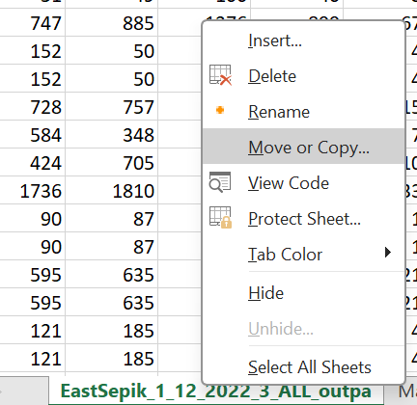
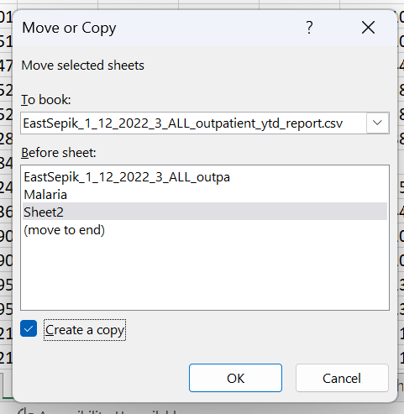
LET’S PREPARE OUR DATA
1. From the sheet containing the raw data, place the arrow/ cursor on the sheet tab and right click
2. From the appeared list box, click on Move or Copy
3. From the appeared dialogue box, select sheet 2 and Check Create a Copy and Click OK
The copy of the sheet will be create on the next tab

Slide 7
Data Cleansing
1. Keep only the data for Yangoru Sausia District and Delete all the other Districts
Do copy and Paste Special
To remove formular from a cell, select and copy the cell, place the arrow on the same cell, right click and Paste Value
To move your data and structure them in a column structure, select the data and copy, place the arrow you want your data to be placed, right click and Paste Transpose. Do it for the other data until you are done.
2. Delete other additional columns, get the sum of the same diseases and delete extra columns

Slide 8
Create Visualization of the Data
1. Prepare and organize you table in a Presentable manner
So lets calculate the AVERAGE first.
Formula; =AVERAGE(D5:D23)
Now we want to visualize our data, which out of our total attendees, what case has recorded the Highest or Lowest.
So now we know our average score, we want to Highlight red in the table to indicate those cases that a above the average line.
So now we know our average score, we want to Highlight red in the table to indicate those cases that a above the average line.
Because we want to create visualization from our data, we may apply some Conditional Formatting

Slide 9
Create Visualization of the Data
Let also create the graphs for our data
So lets calculate the PERCENTAGE.
Formula; =D5/D24*100
D24 is the Total.
D5 is the specific cell
Number to calculate % is always 100
1. First we have to select the data and insert the preferred graph
Make the cell relative by inserting $ sign in D24
Keys to conduct this operation is (Press fn and F4)
Now drag it down to the other cells
2. Customize the graph to suit our liking

Slide 10
Create Visualization of the Data
Format the cell containing the Percentage
Let also create the graphs for our data
Select the Cell, right click and from the appeared list box, select format cell.
1. First we have to select the data and insert the preferred graph
Select the Cell, right click and from the appeared list box, select format cell.
Select Custom, and where it says General, Remove General and enter this 0\% and click ok.
2. Customize the graph to suit our liking
Make D24 relative and drag it down

Slide 11
Create Visualization of the Data
Let also create the graphs for our data
Now from this data, lets insert our graphs and charts
1. First we have to select the data and insert the preferred graph
Column Graph
Bar graph
Line Graph
Pie Chart
2. Customize the graph to suit our liking
Add Heading, Edit or format cells and write descriptions for the graphs

Slide 12
To help you decide on want type of graph you should use, I have prepared a list of Chart Specification to guide you select the appropriate graph to visualize your data.

Slide 13
Charts’ Specification
Visualizing health data effectively depends on the specific type of data and the insights you want to communicate. Here are some types of health data and the appropriate charts to use for each:
Patient Demographics:
  Bar Chart: Compare counts of patients across different age groups, genders, or ethnicities.
  Pie Chart: Show the proportion of different demographics within the patient population.
Disease Incidence/Prevalence:
  Bar Chart: Compare the incidence of different diseases.
  Line Chart: Show trends in disease incidence over time.
  Heatmap: Display incidence rates geographically (e.g., on a map).

Slide 14
Hospital Admissions:
  Bar Chart: Compare the number of admissions by department or reason for admission.
  Line Chart: Display trends in hospital admissions over time.
Patient Outcomes:
  Stacked Bar Chart: Compare outcomes (e.g., recovery, ongoing treatment, deceased) across different treatment methods.
  Pie Chart: Show the proportion of different outcomes for a particular treatment.
Medication Usage:
  Bar Chart: Compare the usage rates of different medications.
  Line Chart: Show trends in medication usage over time.
Health Survey Data:
  Bar Chart: Compare responses to survey questions (e.g., levels of physical activity, dietary habits).
  Pie Chart: Show proportions of different response categories.

Slide 15
Healthcare Costs:
  Bar Chart: Compare costs for different treatments or procedures.
  Line Chart: Display trends in healthcare costs over time.
Patient Satisfaction:
  Bar Chart: Compare satisfaction levels across different departments or services.
  Pie Chart: Show the proportion of patients in different satisfaction categories.
Mortality Rates:
  Line Chart: Display trends in mortality rates over time.
Bar Chart: Compare mortality rates across different diseases or conditions.

