Slide 1
Charts and Graphs

Slide 2
Lesson Topic: Charts and Graphs
Welcome to the fourth lesson of our Excel beginner's guide! In this lesson, we'll explore how to create and customize charts and graphs to visually represent your data.

Slide 3
1. Creating Charts
Charts are powerful tools for visualizing data trends and patterns. Excel offers a variety of chart types to choose from, including bar charts, line charts, pie charts, and more.
a. Selecting Data
Before creating a chart, you need to select the data you want to visualize. Click and drag to select the range of cells containing your data, including column headers if applicable.
b. Inserting a Chart
Once you've selected your data, go to the Insert tab and choose the type of chart you want to create from the Charts group. Selecting a chart type will automatically generate a basic chart based on your data.

Slide 4
2. Customizing Charts
Excel allows you to customize various aspects of your charts to better convey your message.
a. Chart Styles
You can change the style of your chart by selecting one of the predefined chart styles from the Chart Styles gallery in the Chart Tools Design tab. Experiment with different styles to find the one that best suits your data.
b. Adding Titles and Labels
Titles and labels provide context and clarity to your chart. You can add a chart title, axis titles, and data labels by selecting the chart and using the Chart Tools Layout tab.

Slide 5
3. Practice Exercises (Online Using eNHIS Data)
Now it's time to practice creating and customizing charts:
Exercise 1: We will Create a bar chart to visualize Malaria data for 2023
Exercise 2: Customize the chart by adding a title, labelling the axes, and changing the chart style.
These are the information that we want to visualize
1. We want to know the total number of Malaria case being attended.
2. Apart from other Outpatient cases, we want to know the proportional rate of Malaria case being attended to?
3. We want to know the trend of malaria cases being attended to, within a period of 12 months

Slide 6
Charts’ Specification
Visualizing health data effectively depends on the specific type of data and the insights you want to communicate. Here are some types of health data and the appropriate charts to use for each:
Patient Demographics:
  Bar Chart: Compare counts of patients across different age groups, genders, or ethnicities.
  Pie Chart: Show the proportion of different demographics within the patient population.
Disease Incidence/Prevalence:
  Bar Chart: Compare the incidence of different diseases.
  Line Chart: Show trends in disease incidence over time.
  Heatmap: Display incidence rates geographically (e.g., on a map).

Slide 7
Hospital Admissions:
  Bar Chart: Compare the number of admissions by department or reason for admission.
  Line Chart: Display trends in hospital admissions over time.
Patient Outcomes:
  Stacked Bar Chart: Compare outcomes (e.g., recovery, ongoing treatment, deceased) across different treatment methods.
  Pie Chart: Show the proportion of different outcomes for a particular treatment.
Medication Usage:
  Bar Chart: Compare the usage rates of different medications.
  Line Chart: Show trends in medication usage over time.
Health Survey Data:
  Bar Chart: Compare responses to survey questions (e.g., levels of physical activity, dietary habits).
  Pie Chart: Show proportions of different response categories.

Slide 8
Healthcare Costs:
  Bar Chart: Compare costs for different treatments or procedures.
  Line Chart: Display trends in healthcare costs over time.
Patient Satisfaction:
  Bar Chart: Compare satisfaction levels across different departments or services.
  Pie Chart: Show the proportion of patients in different satisfaction categories.
Mortality Rates:
  Line Chart: Display trends in mortality rates over time.
Bar Chart: Compare mortality rates across different diseases or conditions.

Slide 9
Lesson 5: Basic Shortcut Keys
General Shortcuts
Ctrl + N: Create a new workbook.
Ctrl + O: Open an existing workbook.
Ctrl + S: Save the current workbook.
Ctrl + P: Print the current workbook.
Ctrl + W: Close the current workbook.
Ctrl + F: Open the Find and Replace dialog box.
Ctrl + Z: Undo the last action.
Ctrl + Y: Redo the last action.
Navigation Shortcuts
Arrow Keys: Move one cell up, down, left, or right.
Ctrl + Arrow Keys: Move to the edge of the data region.
Ctrl + Home: Move to the beginning of the worksheet.
Ctrl + End: Move to the last cell with data.
Page Up/Page Down: Move one screen up or down.
Alt + Page Up/Alt + Page Down: Move one screen left or right.

Slide 10
Cell and Data Shortcuts
Ctrl + C: Copy selected cells.
Ctrl + X: Cut selected cells.
Ctrl + V: Paste copied or cut cells.
Ctrl + D: Fill down (copy the cell above).
Ctrl + R: Fill right (copy the cell to the left).
Ctrl + -: Delete selected cells.
Ctrl + Shift + +: Insert new cells.
Ctrl + Space: Select the entire column.
Shift + Space: Select the entire row.
Ctrl + Shift + L: Toggle filters on/off.
Formatting Shortcuts
Ctrl + B: Apply or remove bold formatting.
Ctrl + I: Apply or remove italic formatting.
Ctrl + U: Apply or remove underline formatting.
Ctrl + 1: Open the Format Cells dialog box.
Ctrl + T: Create a table.
Ctrl + Shift + $: Apply the currency format.
Ctrl + Shift + %: Apply the percentage format.
Ctrl + Shift + #: Apply the date format.

Slide 11
Formula Shortcuts
=: Start a formula.
Ctrl + `: Toggle the display of formulas.
Alt + =: Insert the SUM function.
Ctrl + Shift + Enter: Enter an array formula.
F4: Cycle through absolute and relative references in a formula.
Miscellaneous Shortcuts
F2: Edit the active cell.
Ctrl + A: Select the entire worksheet.
Ctrl + F1: Show or hide the ribbon.
F12: Open the Save As dialog box.
Alt + Enter: Start a new line within a cell.

Slide 12
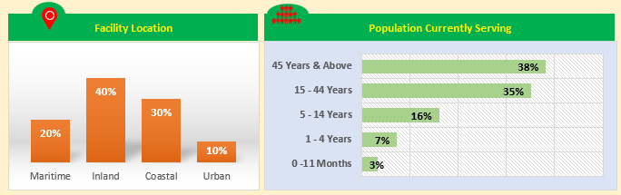
Column Graph
Bar Graph

Slide 13
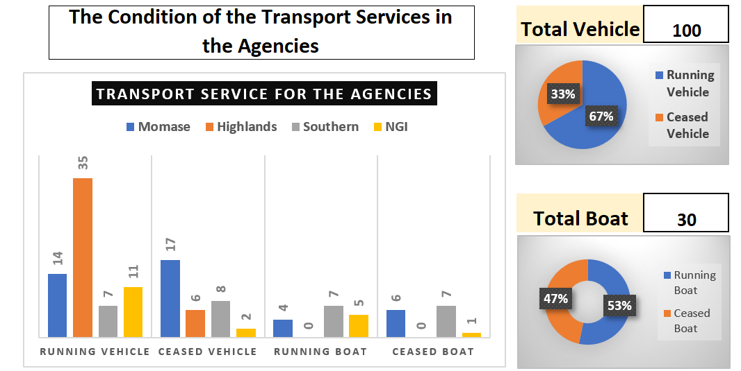
Column Graph
Pie
Doughnut

Slide 14
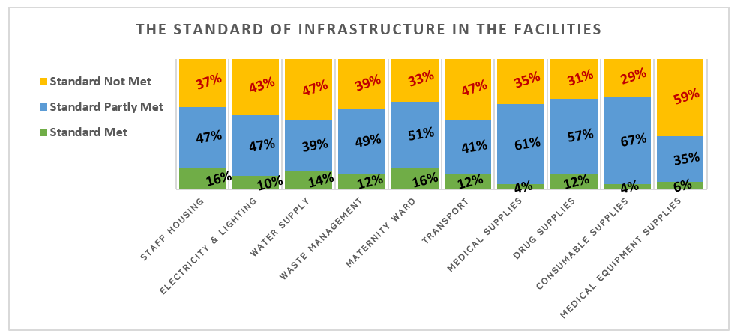
Stack Graph

Slide 15
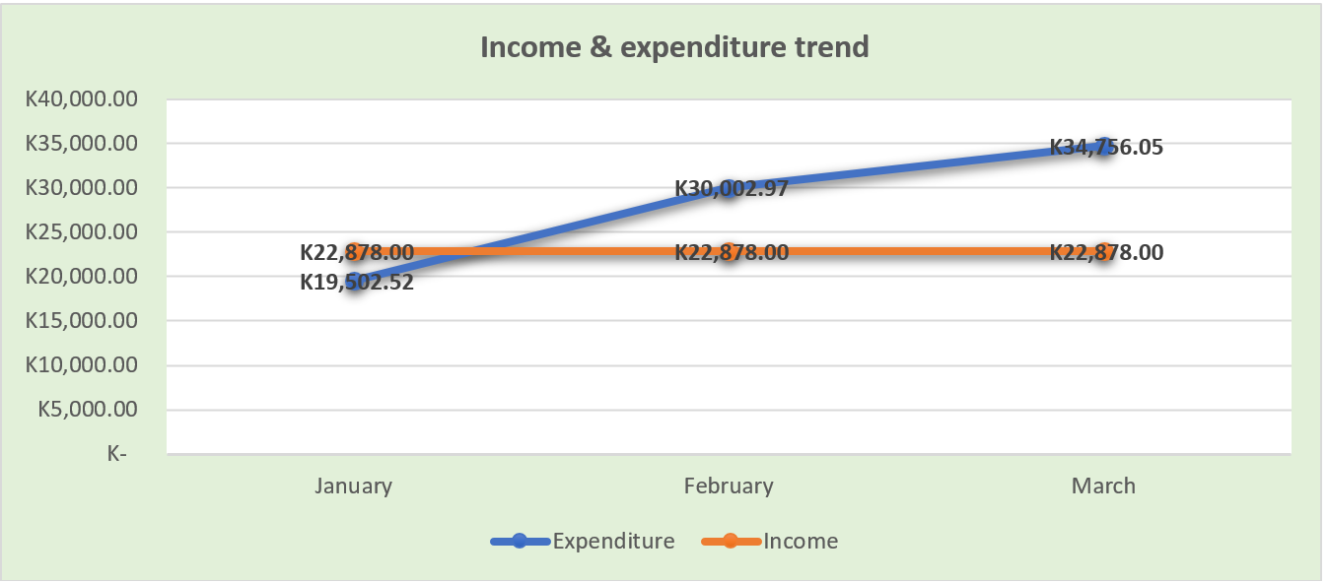
Line Graph

